Slide 1
API Abuse
Yash Patel (2310624)
Armin khalegi rad (2310539)
Rakshit sain (2310453)

Slide 2
Outline
Introduction
What is API Abuse ?
Impact
Common Vulnerabilities Exploited
Motivations Behind API Abuse
Prevention Strategies
Implementing API Security
Demos (Attack & Prevention)
Technology use
Q&A

Slide 3
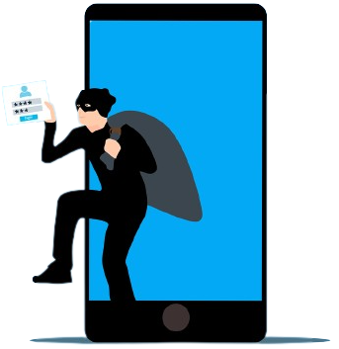
Introduction
In our digital world, software talks to each other through something called APIs. These APIs help apps and programs work together smoothly.
But sometimes, bad people try to take advantage of these APIs. They might try to steal information, crash systems, or cause trouble.
APIs are like the doors to your digital house. If they're not secure, the bad guys can break in. So, it's really important to keep them safe.
Today, we're going to learn about API abuse, what harm it can cause, and some simple steps we can take to stop the bad guys in their tracks.
By the end, you'll know how to protect your digital 'house' and keep your data and systems safe from API troublemakers.

Slide 4
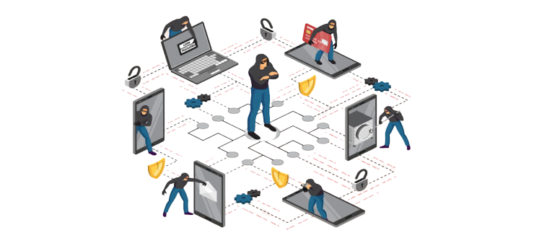
What is API Abuse?
API abuse is when someone uses an application's interface in a harmful or unauthorized way. It's like a person trying to pick a lock to break into a house.
People who abuse APIs might try to steal information, crash systems, or do things they're not supposed to.
API abuse can lead to data leaks, system crashes, and even financial losses.
Just like you lock your doors to keep your home safe, developers need to secure APIs to prevent abuse and protect data.

Slide 5
Type of API Abuse.
Unauthorized Access: Attackers try to get into systems they shouldn't be in. It's like someone sneaking into a building without a key.
Denial of Service (DoS): Imagine a traffic jam that stops everyone from moving. In the digital world, attackers flood a system, making it crash and unavailable.
Data Scraping: This is like someone secretly collecting your personal information. Attackers use automated tools to steal data from systems.
Brute Force Attacks: Just like trying all possible keys until one fits, hackers use this to guess passwords or codes.
API Rate Limiting Violations: Imagine repeatedly ringing a doorbell to annoy. Attackers exceed allowed limits, disrupting services.
API Token/Key Theft: This is like someone stealing your house keys. Hackers take API tokens or keys to pretend they're authorized.

Slide 6

Impacts
Data Breaches: API abuse can lead to unauthorized access to sensitive information, resulting in data leaks. It's like someone breaking into a vault and stealing valuables.
System Downtime: When attackers overload systems, they can crash services. This disrupts operations and frustrates users, just like a power outage in a neighborhood.
Financial Losses: API abuse can cause companies to lose money through downtime, stolen data, and damage to reputation. It's like a shop losing customers due to bad service.
Reputation Damage: If customers lose trust in a company's security, they might take their business elsewhere. It's like a house losing its value due to safety concerns in the neighborhood.
Legal Consequences: Companies can face legal actions if user data is compromised. It's like being sued for not securing your house properly.
Overall Chaos: API abuse doesn't just affect companies—it can disrupt entire online ecosystems. It's like one house in a row causing problems for the whole neighborhood.
Mitigation: By understanding the potential impact, we can work to prevent API abuse and protect both data and reputation.

Slide 7

Common Vulnerabilities Exploited
Lack of Input Validation: Imagine accepting any package without checking its contents. This vulnerability allows attackers to inject harmful code, leading to breaches.
Insecure Data Transmission: Sending data without protection is like shouting sensitive information in public. Hackers can intercept and steal data during transmission.
Insufficient Rate Limiting: Not limiting requests is like allowing someone to ring your doorbell non-stop. Attackers overload systems by sending too many requests.
Insecure Storage of API Keys/Tokens: Storing keys where anyone can find them is like leaving your house keys in the open. Attackers steal keys to gain unauthorized access.
Broken Authentication Flow: Think of this as someone tricking you into opening the door for them. Attackers exploit flaws in the login process.
Zero-Day Vulnerabilities: These are like secret passages only attackers know about. They use undiscovered weaknesses to breach systems.
Mitigation and Best Practices: Understanding these vulnerabilities helps us reinforce our APIs. Implement strong authentication, validate inputs, encrypt data, and secure keys.

Slide 8

Prevention Strategies for API Abuse
Robust Authentication and Authorization:
Use strong locks for your digital doors. Implement methods like OAuth or JWT for secure access.
Assign specific access levels to users through Role-based access control (RBAC).
Input Validation and Sanitization:
Inspect and clean what's coming in. Validate input data to prevent attacks like SQL injection and cross-site scripting (XSS).
Secure Data Transmission:
Encrypt data like sending it in a locked box. Use HTTPS (TLS/SSL) to safeguard data during transit.
Effective Rate Limiting and Throttling:
Prevent overcrowding at the door. Set sensible limits on how often requests can be made.
CAPTCHA or reCAPTCHA Implementation:
Stop bots from knocking. Use CAPTCHA challenges to ensure requests are made by humans.
Regular Security Audits and Penetration Testing:
Periodically check your locks. Conduct thorough tests to find and fix vulnerabilities.

Slide 9
Prevention Strategies for API Abuse
API Security Tools:
Deploy guardians at your entrance. Tools like API Gateways, Web Application Firewalls (WAFs), and Intrusion Detection Systems (IDS) help protect APIs. Regular Updates and Patches:
Keep your locks up-to-date. Regularly update your APIs and associated software to fix security vulnerabilities.
User Education:
Teach users about security. Educated users can help prevent breaches through responsible API usage.
Real-time Monitoring and Logging:
Keep watch on who's knocking. Monitor traffic and maintain logs to detect and respond to suspicious activity.
Collaboration with Security Experts:
Consult with the locksmiths. Work with security professionals to identify and implement best practices.

Slide 10
Implementing API Security
API Gateway: Centralized Control:
Think of it as a security checkpoint. An API gateway manages access, enforces security policies, and filters traffic.
Web Application Firewall (WAF):
Like a protective shield. A WAF blocks malicious traffic and filters out threats before they reach your APIs.
Monitoring and Logging:
Digital security cameras. Monitor API traffic and keep detailed logs to track and analyze activity.
Real-time Traffic Analysis:
Watching for unusual behavior. Analyze incoming and outgoing traffic patterns to identify anomalies.
Encryption: Protecting Data in Transit and Storage:
Securing your data with a lock. Encrypt data as it moves between systems and when stored.
Regular Security Audits and Penetration Testing:
Scheduled security checks. Test your APIs for vulnerabilities and fix them promptly.

Slide 11
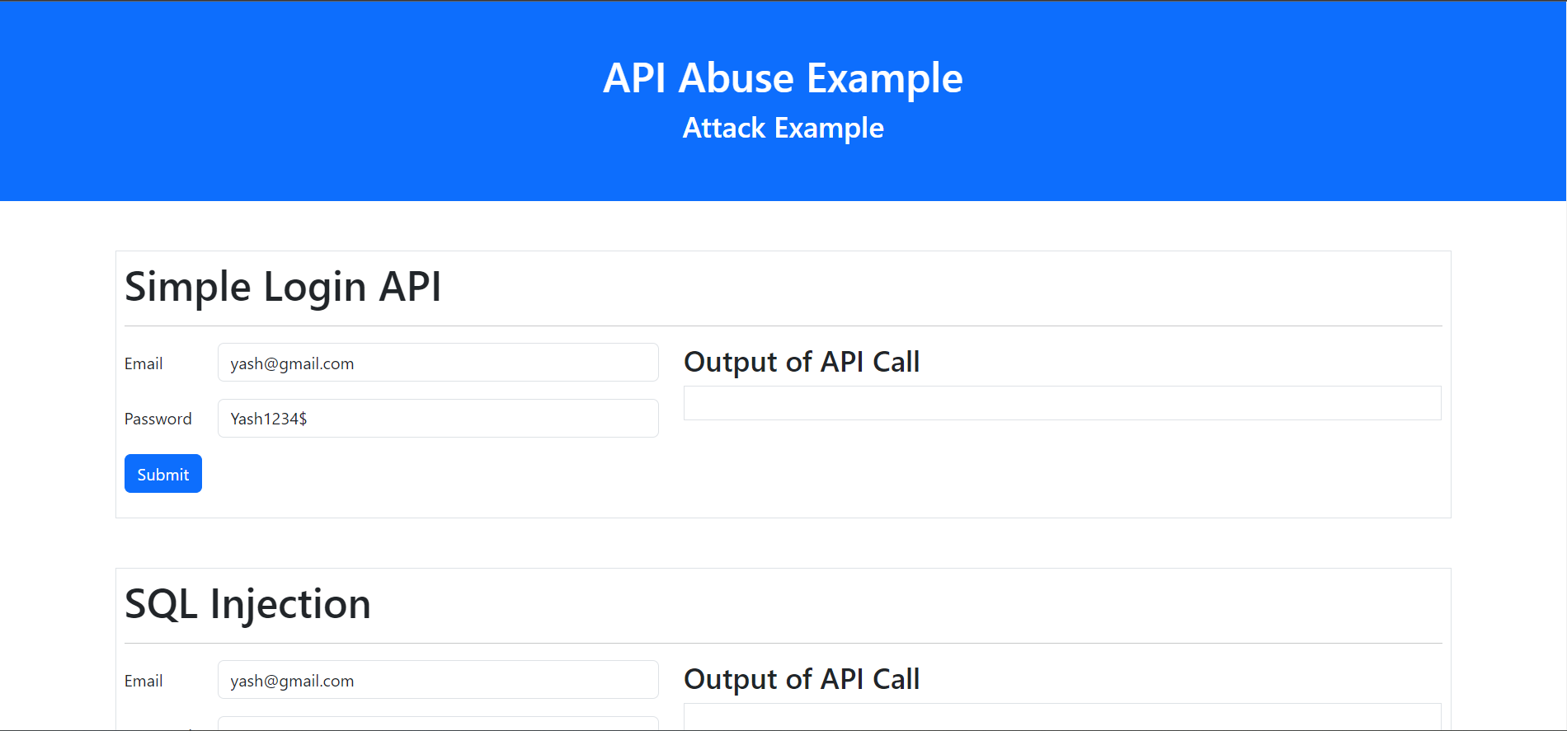
What We have Implement?
Step 1 : Created a Simple Attack page from where we can test the attacks

Slide 12
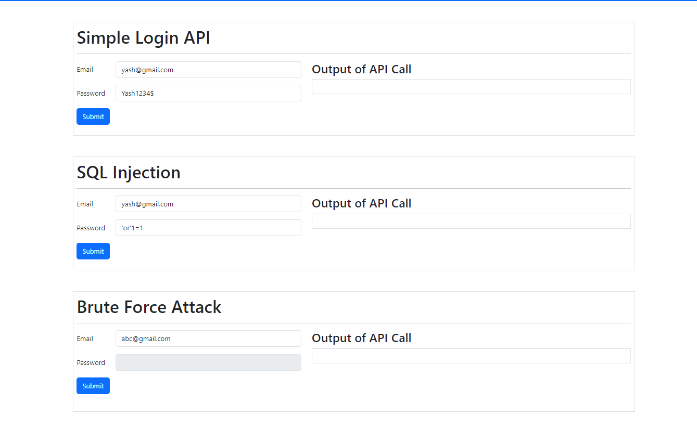
Step 2 : Added 3 Forms and created a Login API.
Simple Login API
SQL Injection
Brute force Attack

Slide 13
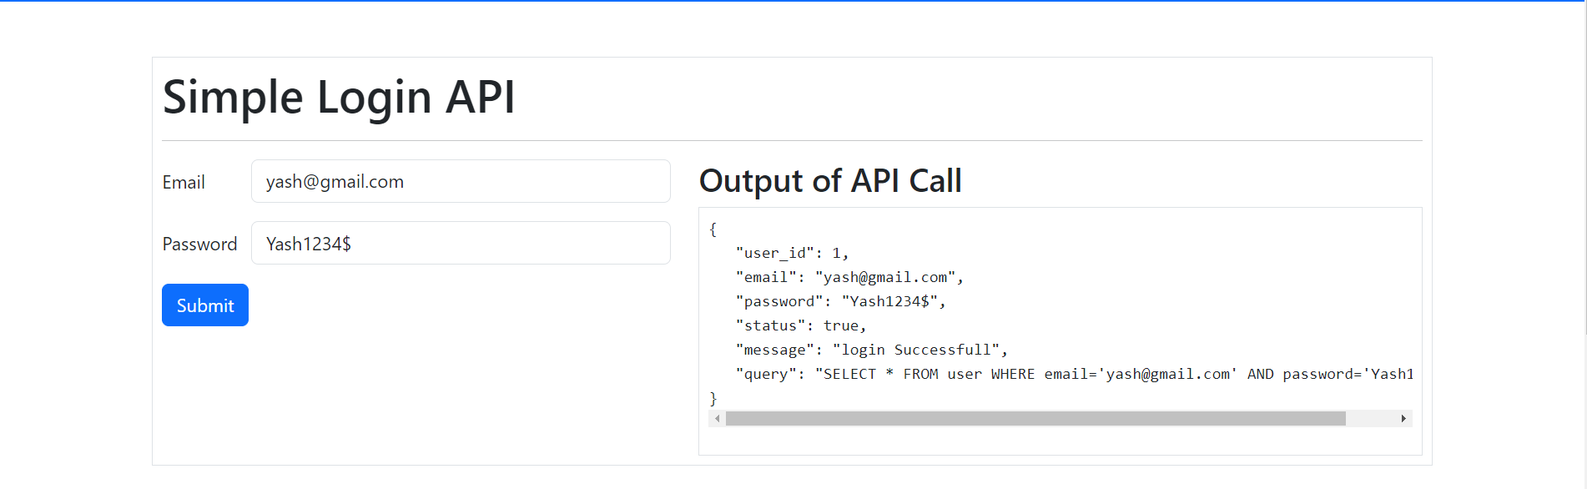
1. Simple Login API

Slide 14
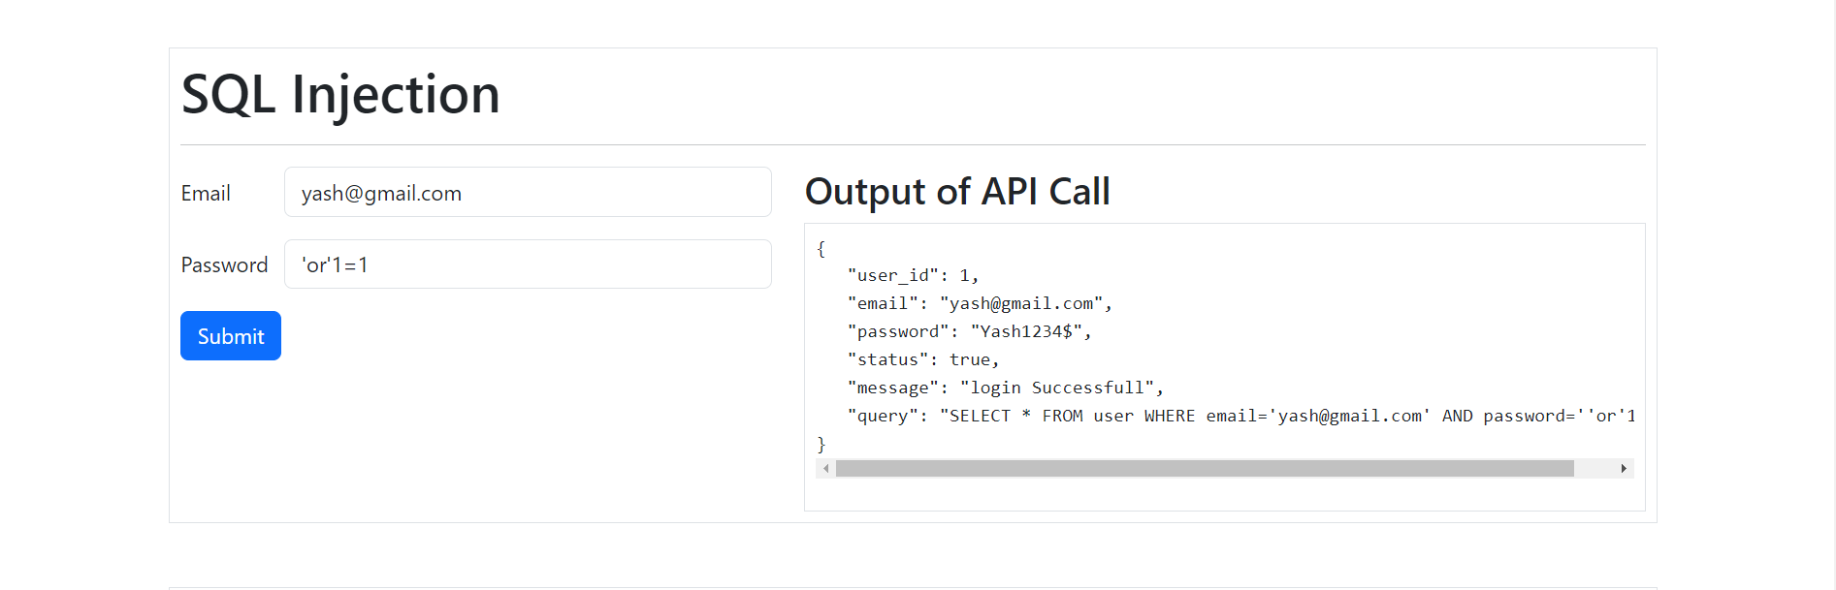
2. SQL Injection

Slide 15
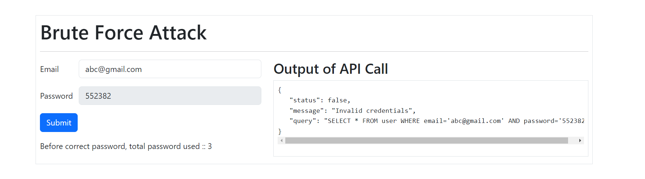
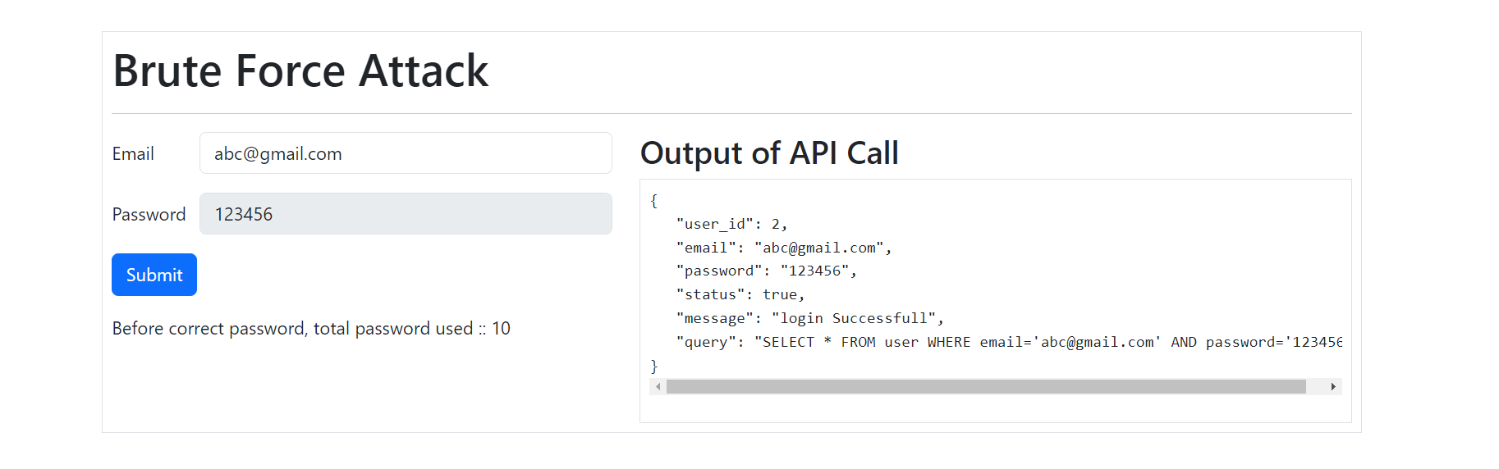
3. Brute Force Attack

Slide 16
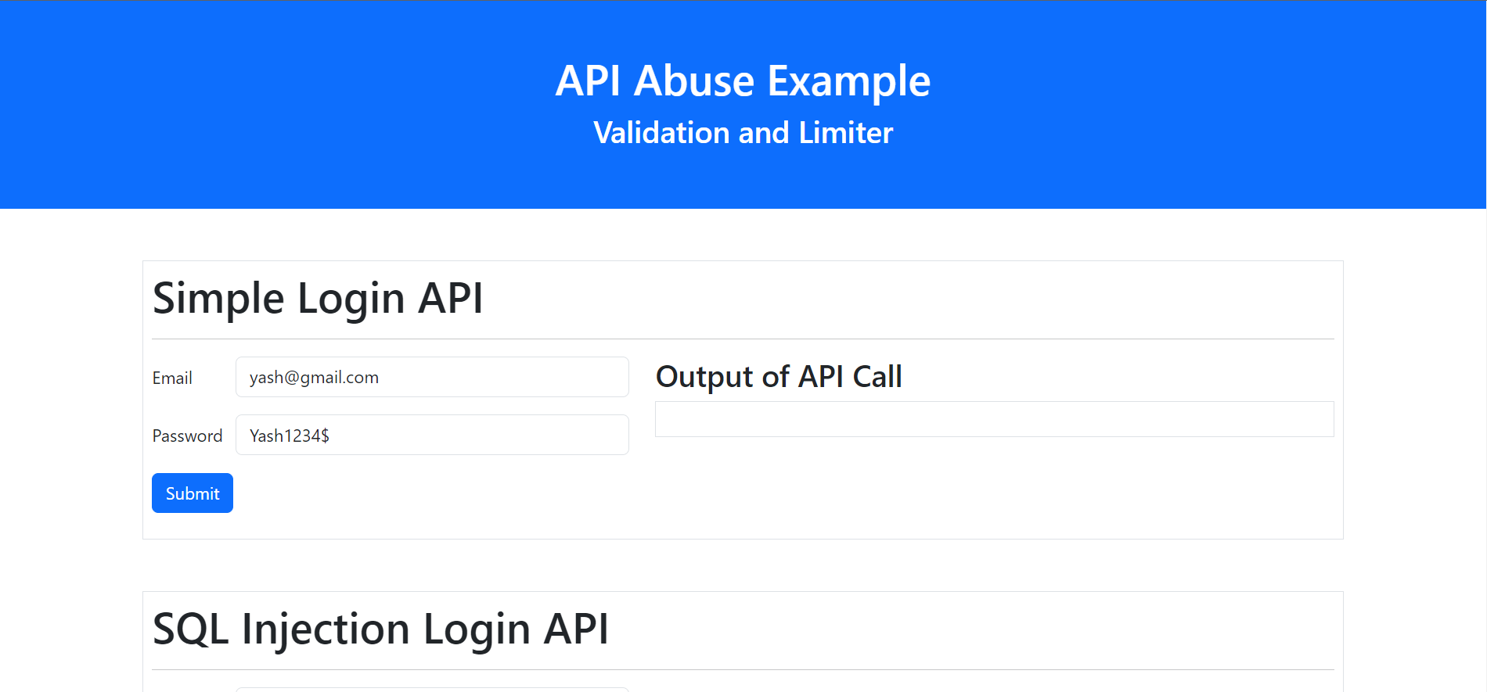
Step 3 : Created another page that prevent the attacks:

Slide 17
Step 2 : Added 3 Forms with validators and A login API with rate limiter.
Simple Login API
SQL Injection
Brute force Attack

Slide 18
1. Simple Login API

Slide 19
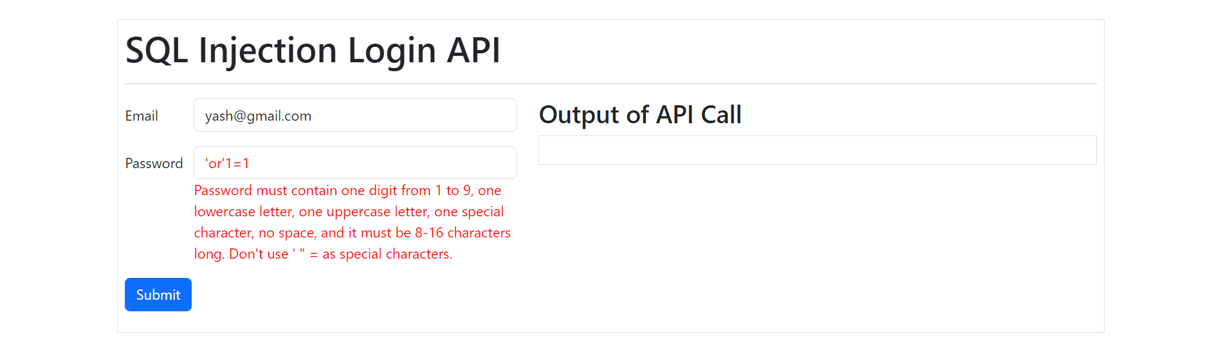
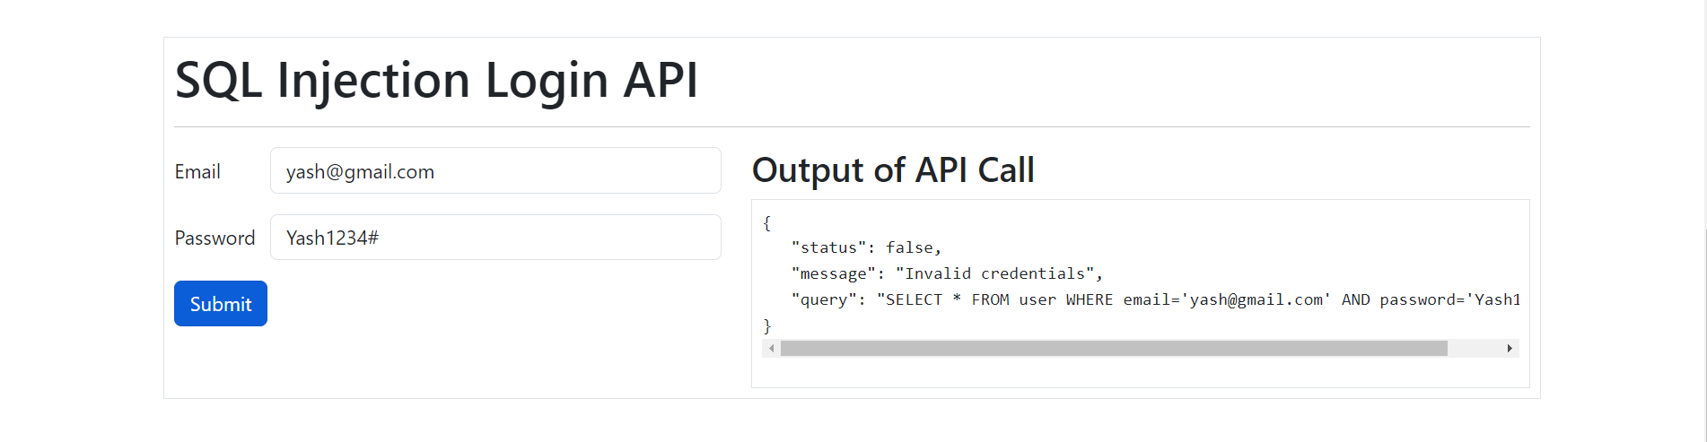
2. SQL Injection Form with validators

Slide 20
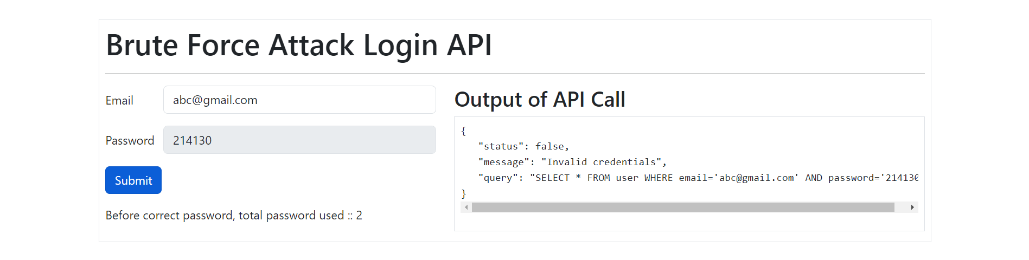
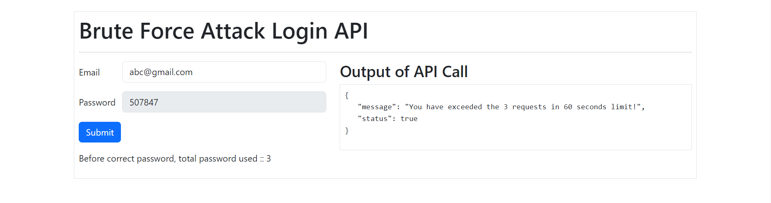
3. Brute Force Attack Form with Rate Limiter in backend:

Slide 21
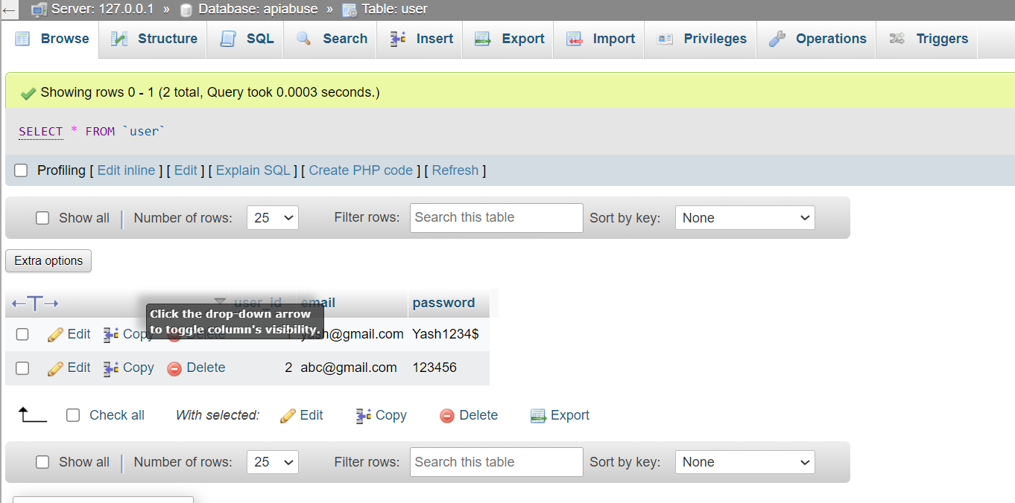
Database : MySQL
Database Name : apiabuse → Table name : user

Slide 22
APIs:
We have created two APIs for this demos:
http://localhost:5000/api/users/login
Type : POST
Data :{
Email: “”,
Password :””
}
http://localhost:5000/api/users/bruteForceLogin (With rate Limiter)
Type : POST
Data :{
Email: “”,
Password :””
}

Slide 23
What technology we use ?
Back-End :
NodeJS (Express JS)
MySQL (package)
Express rate limit (package)
Server and Database :
Xampp (Apache)
MySQL
Front-End :
Bootstrap
JQuery
Validate JS (Regex)

Slide 24
Resources
Project URL : https://github.com/yashpatel521/API-Abuse
Bootstrap :
https://getbootstrap.com/
JQuery:
https://jquery.com/
Validate JS:
https://validatejs.org/
Express JS :
https://expressjs.com/
Express rate limiter :
https://www.npmjs.com/package/express-rate-limit
MySQL :
https://www.npmjs.com/package/mysql

Slide 25

Thank You ….
Any Questions

